Slide 1
18ECO133T Sensors and Transducers 3 Credit Course UNIT III
Dr.M.Shunmugathammal
Assistant Professor
Department of ECE
SRMIST Ramapuram Campus

Slide 2
Thermal sensors: Introduction
Thermal Expansion type.
Acoustics temperature sensors
Thermo-emf sensor.
Materials for thermos-emf sensors
Thermocouple construction, Types.
Thermo-sensors using semiconductor device
Pyroelectric thermal sensors
Introduction, characteristics, Application
Radiation sensors, Introduction, Characteristics
Geiger counters, Scintillation detectors
Application on radiation sensors

Slide 3
THERMAL SENSORS - INTRODUCTION
Thermal sensors are primarily temperature sensors also called thermodynamic sensors.
Any physical quantity say Q is usually expressed as its magnitude in number N and in unit U so that
If it is possible to relate temperature T directly in the above form of above equation, from the first principles, in a sensing system, then it is called a primary sensor.
Even though the principles of thermal sensing are well established, newer innovations are added to the stock of sensors dependent on these principles with improved quality and better practical approaches.
Many of the commonly used practical 'thermometers' are, however, not primary in that sense and may be called secondary as the relationship between Q and T used by them is largely empirical.
Q = NU

Slide 4
Classification of sensors
Primary Sensors
Gas Thermometer
Vapour Pressure type
Ultrasonic type
Dielectric constant type
Magnetic type
Noise type
Nuclear Orientation type

Slide 5
Classification of sensors
Secondary Sensors
Thermal Expansion type
Thermo emf type
Diode, Transistors or semiconductor type
Adapted Radiation type
Resistance Thermometer type
There are different kinds of heat flux sensors which measure heat flux in terms of temperature difference.
Even in temperature measurement. there are special types of sensors such as pneumatic type, pyroelectric type and so on.

Slide 6
THERMAL EXPANSION TYPE THERMOMETRIC SENSORS
The thermal expansion types thermometric sensors are, perhaps. the oldest varieties still used commercially to a certain extent.
Earliest of this kind is the solid expansion type bimetallic sensor which uses the difference in thermal expansion coefficients of different metals.
Two metal strips A and B of thickness ta and tb, thermal expansion coefficients a_{A} and a_{B} are firmly bonded together at a temperature, usually the lowest or the reference temperature, to form a cantilever or a helix with one end fixed as shown in Figs 3.4(a) and 3.4(b) respectively.

Slide 7
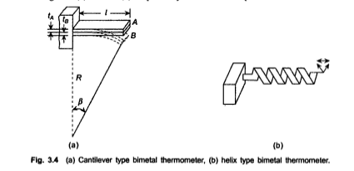

Slide 8
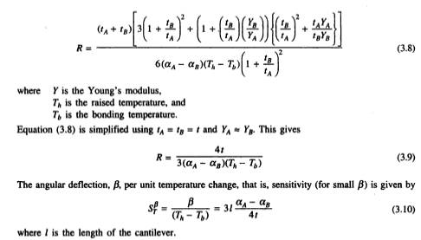

Slide 9
When the temperature of the cantilever or the helix is raised by heating or lowered by cooling. one strip expands or contracts more and free end of either of the two moves as shown.
The cantilever, in fact, bends into a circular arc with radius of curvature R given by the relation
increases linearly with length and inversely with strip thickness for a given pair of metal elements. Usually element B is made of invar (e Ni-Fe alloy) of a_{s} 1.7 x 10⁴/°C which is quite low and element A is brass or steel of different alloying compositions. Such sensors can work precisely but not very accurately in a range -50-400°C.
Besides cantilever and helix forms, they are also made in spiral and disc forms in different control applications.

Slide 10
LIQUID-IN –GLASS THERMOMETER
Liquid-in- glass thermometer
In liquid-in-glass thermometer—the liquid in majority of the cases being mercury. With mercury, this thermometer is almost the basic temperature measuring unit in home (as clinical thermometer), in laboratories and even in industries.
It utilizes the expansion property of the liquid kept in a bulb to which a capillary. closed at the fer end, is attached through which the expanded liquid rises and an indication in mm, calibrated directly in temperature scale, is obtained.

Slide 11
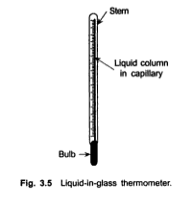
The schematic is shown in Fig. 3.5 The range of mercury thermometer is normally -35-300°C and the upper limit is 357°C. its boiling point.
The range can be extended upto 600°C by filling the volume above mercury with pressurized dry nitrogen.
The volume of the bulb is made 100 to 400 times larger than the capillary volume. Other liquids used as expansion media are given in Table 3.3 with their corresponding ranges.

Slide 12
LIQUID | RANGE(DEGREE CENTIGRADE)
PENTANE | -200-30
ALCOHOL | -80-70
TOLUENE | -80-100
CREOSOTE | -5-200
When the measurement is made, the thermometer should be immersed upto the meniscus in the capillary which means that the thermometer is to be moved for varying temperatures.
Alternatively, the entire thermometer is immersed, or, only the bulb is immersed. The last alternative is the most common one and for this purpose. a correction has to be applied for the mercury column above the immersion line because the column is at a different temperature c than the measured value t.,.

Slide 13

The correction term is
An extension of this is the industrial type liquid filled-in system which consists of a metallic bulb attached to a metallic capillary. The other end of capillary is fitted with a Bourdon. The expansion of the liquid in the bulb is transmitted to the Bourdon which uncurls in the usual manner.
A number of compensations are necessary to obtain correct indication by the measurement system using such a sensor.
The correction methods are available in standard texts on industrial instrumentation.

Slide 14
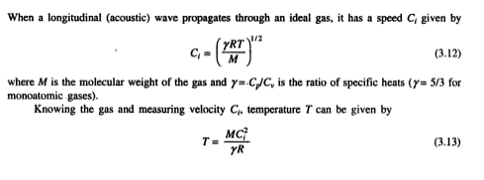
ACOUSTIC TEMPERATURE SENSOR
The realization of this technique is made in acoustic helium interferometer whose working is explained through Fig. 3.6.
A quartz crystal excited to its resonance frequency is used to transmit this wave through a gas (He) column. to be faced by a piston. The wave is reflected at the piston surface to form a pattern as shown.

Slide 15
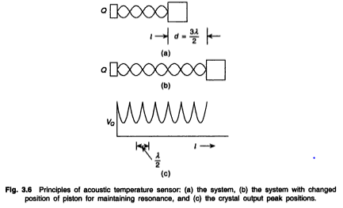
When the path length l has a multiple number of half-wavelengths and correspondingly the gas column is set to resonate at each such half-wavelength gap, with the piston moving away from the crystal at each resonant peak, the crystal gives out maximum energy and hence the voltage V_{Q} across the crystal defines peaks as shown in Fig. 3.6(c).
If the piston moves by a distance d to give n such peaks, d = nλ/2 from which C, is determined and thence temperature T. The piston movement must be accurately monitored to within, say 1 μm.

Slide 16
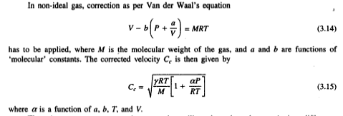
There is a nonresonant acoustic sensor that utilizes the pulse-echo transit time difference which changes with temperature. Figure 3.7 is a schematic representation of the sensory pans of the measurement system.
An ultrasonic pulse is transmitted through the sensor, a part of which is reflected at the entrance (a discontinuity) and a part at the end, as shown.
The reflected pulses are received by the transreceiver coil at an interval of called the transit time.

Slide 17
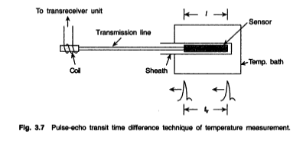
The pulse that travels the entire length of the sensor is delayed more/less depending on the change in the sensor temperature.
This temperature dependence is a function of the path length I. sensor material. temperature range, and vibration mode even if the first echo is considered.
The materials which show distinctive r„ are listed in Table 3.4 with their temperature ranges.

Slide 18
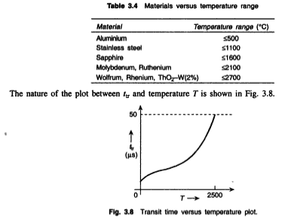

Slide 19
The sensor may be made in the form of a thin wire with restrictions or constrictions at intervals of space where the reflections would occur.
The wire diameter varies from 0.03-3 mm and spacing between restrictions varies from 5-10 mm in a sensor length of 15-50 mm, and a number of echos can then be produced.
There should not be any inhomogeneity in the material faced by the wave except for the restrictions.

Slide 20
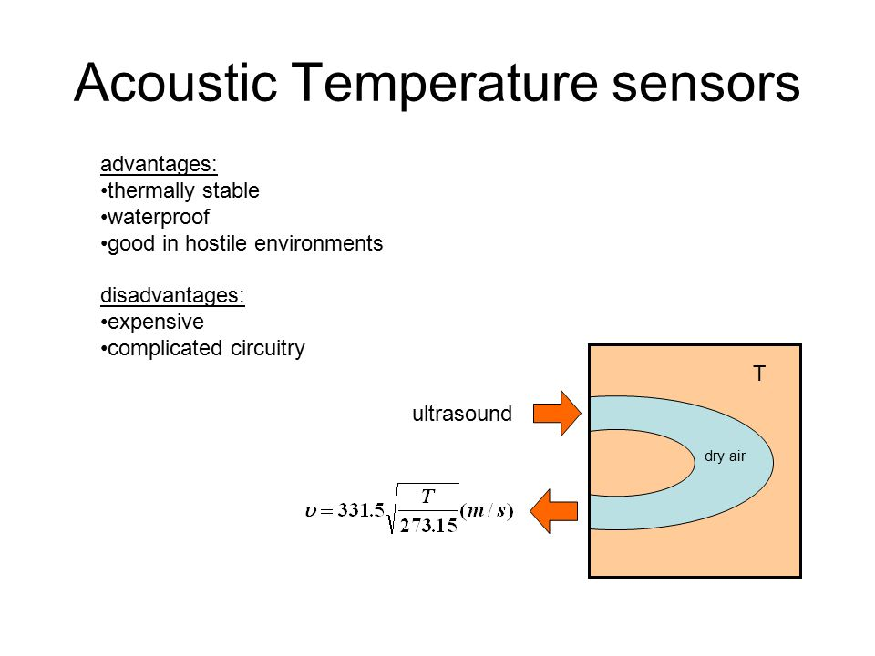
ACOUSTIC TEMPERATURE SENSOR

Slide 21
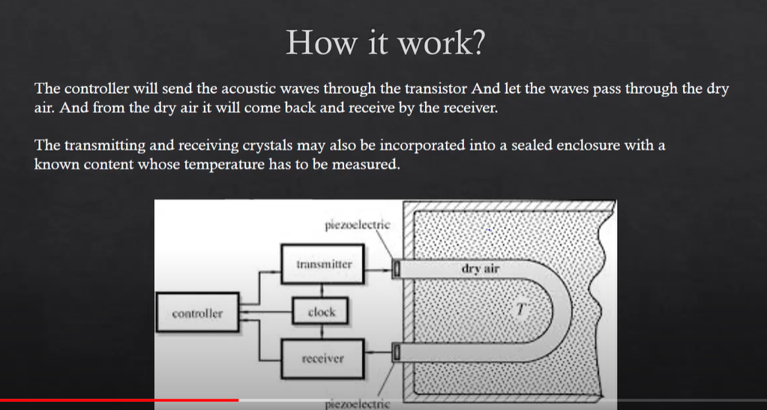

Slide 22
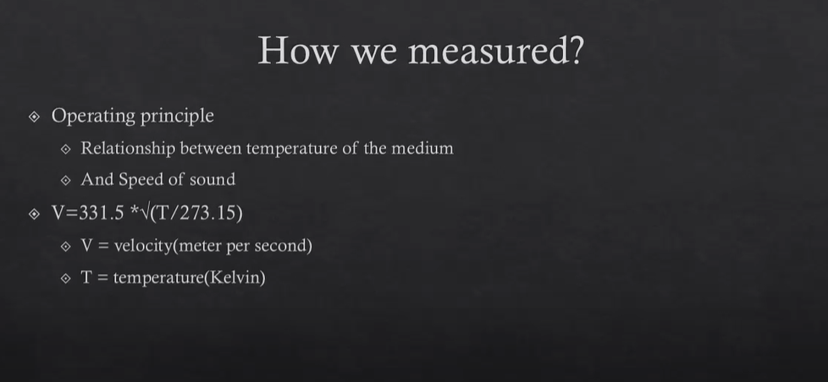

Slide 23


Slide 24
THERMOEMF SENSORS
Thermoemf temperature semen are thermocouples which arc most extensively used in industry, over a wide range of temperatures. The range, however, is made wide using different materials The measurement does not involve separate supply.
A resolution of 0.1-0.2°C at ambient condition is obtained which increases at high values to about +5°C.
It was discovered by J. Seebeck that when two conductors C1, and C2 of different compositions arc made up into a closed electrical circuit as shown in Figure.
Refer pdf

Slide 25
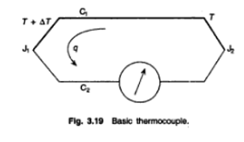
The Seebeck emf has been found to be the algebraic sum of two potentials named after their discoverers—Peltier and Thomson
The 'Peltier effect states that one of the junctions is heated and other cooled lf a current is allowed to flow in the circuit, the amount of the temperature rise in one junction and the amount of temperature fall in the other as also which will be heated and which cooled, will depend on the current intensity and direction, besides the compositions of the conductors.
The electrons travelling across the junctions actually do some work or some energy forces them to easel across the junctions, that is, the thermal energy of the electrons is either higher or lower which causes the junctions to get heated or cooled.

Slide 26
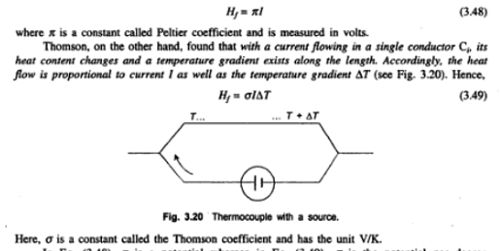
The heat flow H_{f} (power) across the circuit is proportional to current f in the circuit so that.

Slide 27
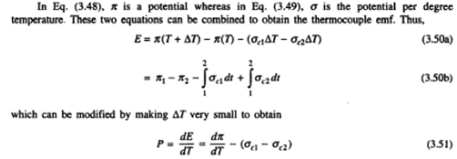
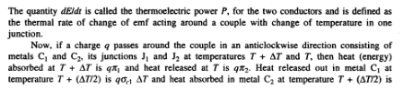

Slide 28
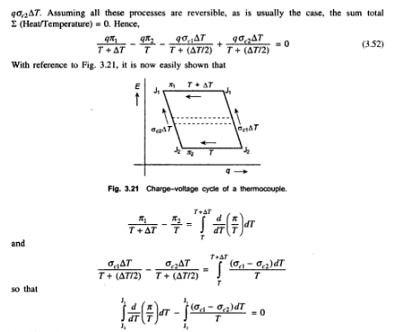

Slide 29
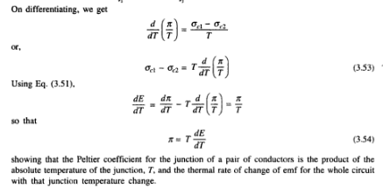

Slide 30
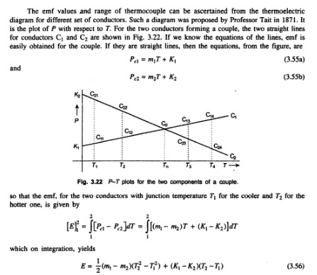

Slide 31
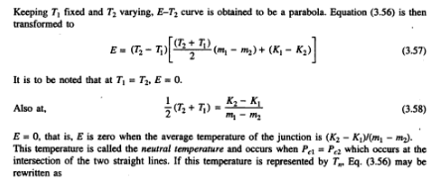

Slide 32
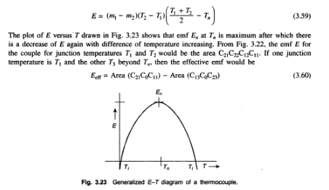

Slide 33
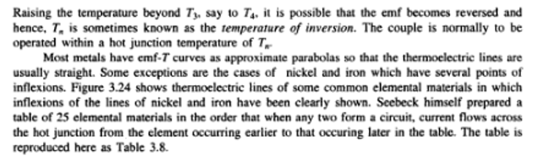

Slide 34
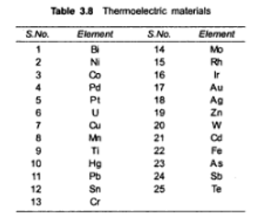

Slide 35
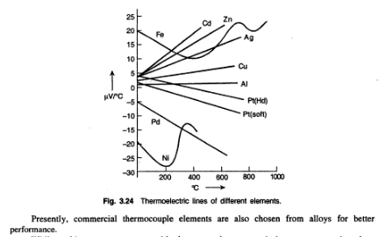

Slide 36
While making a measurement with thermocouple sensors. it is necessary to introduce measuring Instruments which therefore, are likely to affect the thermoemf property of the couple. Some new junctions, in effect are formed because of these insertions.
The ideal conditions leading to the thermoemf generation for a couple are rarely met in practice and more often than not empirical situations arise and calibration of the measuring system with the thermoemf transducer becomes necessary.

Slide 37
Some laws of the behavior of the thermocouple have accordingly been derived. These are
1. Low of Intermediate temperature: The emf for a couple. each element of which is homogeneous in constitution, with junctions at temperatures T1, and T2 is not affected by temperatures elsewhere in the circuit.
2. Law of Intermediate metals: If a third homogeneous metal is inserted anywhere in the couple without affecting the junctions J1, and J2 and their temperatures T1 and T2, and the new junctions of the asserted metal having identical temperature, the thermoemf of the couple remains unaffected.
3. Law of homogeneous circuits: If the circuit is made of a single homogeneous metal, no current flows through the application of heat done and no thermoemf develops.

Slide 38
MATERIALS FOR THERMOEMF SENSORS
Materials for Thermoemf Sensors
Material choice is guided by quite a few important factors:
(a) high thermoemf per unit temperature change. that is. high thermoelectric power.
(b) low electrical resistance of the couple.
(c) linearity of E-T curve over the range of Interest.
(d) high melting point of the couple materials for wider range,
(e) material should be available as pure and homogeneous, workable in desired shapes and should not be easily contaminable.
(f) should be usable over king period of time without getting brittle. or acquiring scales. or change of composition (for alloy type materials).
(g) should be properly annealed to make it free from Mains/stresses produced during cold drawing process.

Slide 39
Elemental materials listed by Seebeck are not all suitable for commercial pairing to form thermocouples. Throe categories of thermocouple do mist in practice. namely
the base metal type consisting of couple members made of elemental base metals or alloys thereof.
the noble / Precious metal type made from noble metals or alloys thereof. and
nonmetallic types.
Thermocouples are usually Identified by capital letters of the English alphabet. The base metal types are identified by letters E, I, K, N, and T; and the noble metals thermocouples are identified by G, C, D, B, R, and S. Nonmetallic thermocouples are special kind and will be considered separately.
Several countries have included this standardized nomenclature f type tenets in specification schedule providing temperature range, tolerance, service. (intermittent or continuous). and quality (standard or special). International Electrotechnical Commission (IEC) publication 584 with various parts (1, 2, 3) is such a standardizing document. Table 3.9 shows a specification sheet of the various types of couples.

Slide 40
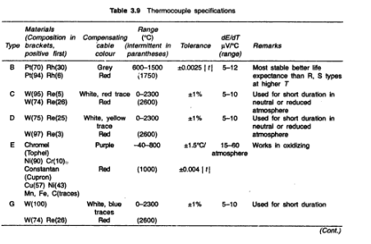

Slide 41
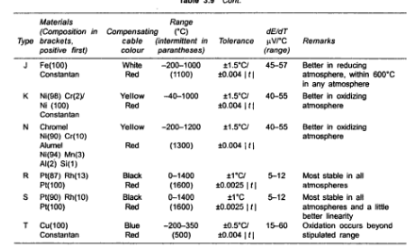

Slide 42
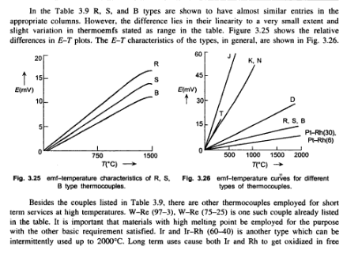

Slide 43
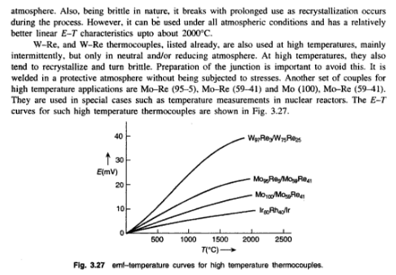

Slide 44
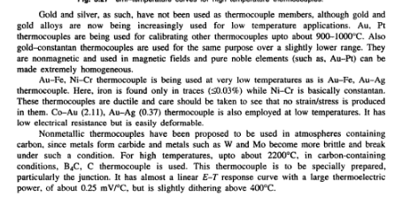

Slide 45
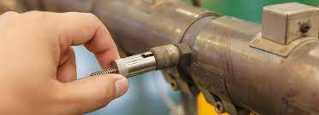
thermocouple
Thermocouple
A thermocouple is a device for measuring temperature.
It comprises two dissimilar metallic wires joined together to form a junction.
When the junction is heated or cooled, a small voltage is generated in the electrical circuit of the thermocouple which can be measured, and this corresponds to temperature.

Slide 46
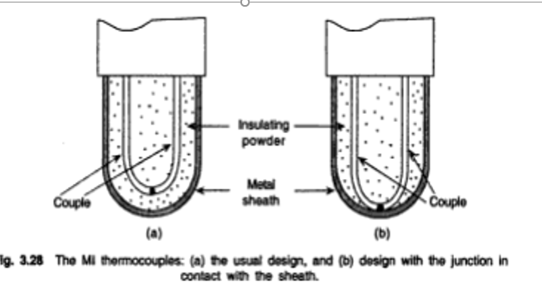

Slide 47
https://www.youtube.com/watch?v=v7NUi88Lxi8 -How Thermocouples Work - basic working principle + RTD

Slide 48
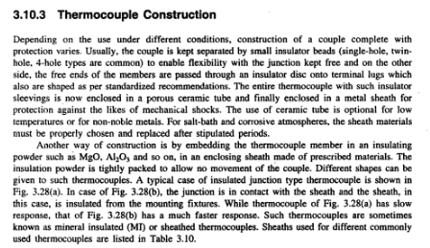

Slide 49
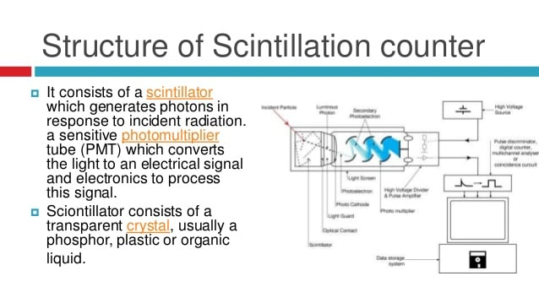

Slide 50
Radiation Sensors
Radiation detectors, also called radiation sensors, are instruments that sense and measure radiation emissions or levels of radiation produced by a source.
When radiation passes inside a detector, it causes ionization of gas atoms, separating atoms into positive ions and electrons. Separated electrons and positive ions are attracted to the electrodes, causing a current to flow. This is converted into electric signals, which are then measured as the amount of radiation.

Slide 51
Types of Radiation Sensors
There are three different main types of radiation detectors. These are detectors based on gas ionization, scintillation detectors, and semiconductor detectors.
Detectors based on gas ionization are the ionization chamber, proportional counter, and Geiger–Müller counter.

Slide 52
Use of Radiation Sensors
A radiation detector is a device used to track, detect, or identify high-energy particles or radiation from natural or artificial sources such as cosmic radiation, nuclear decay, particle accelerators, and X-rays.

Slide 53
Radiation Sensors
Radiation sensors are also called as Sensistors.
It can be classified as
Photoelectric cell such as Photo emissive cell.
Photoemf cell such as Photovoltaic, barrier layer, boundary layer type
Photoconductive cell such as light sensitive resistors.

Slide 54
Radiation Sensors
Photosensistor was considered as a combination of two electrodes in an electrolyte.
According to the radiation changes, frequency or wavelength ,the electrodes change in Size and shape and the nature of electrolyte also changes i.e gas, liquid or solid.
One of the fundamental laws on which some of these sensors are based is the Photoelectric effect.

Slide 55
Radiation Sensors
Radiation energy propagating through space in quanta when collides with matter, certain integral number of quanta called photons are emitted, reflected and others absorbed depending on the material characteristics.
The intensity of incident radiation determines the number of electrons released.
The mechanism is explained by the band structure.

Slide 56
Radiation Sensors
If the photon energy is sufficient to raise an electron in the material to a vacant conductivity band level , the electrical conductivity of the material increases.
Two situations may now arise:
The incident radiation energy hv is just sufficient to transfer an electron into a vacant conductivity level and not beyond. This process leads to increased photoelectric conductance of a substance and the effect is sometimes referred to as Inner photoelectric Effect.

Slide 57
Radiation Sensors
If incident radiation energy hv is high enough, it then causes the electron to be detached and emitted from the material. This is known as the Outer photoelectric effect and is effective in gaseous systems.

Slide 58
Application of Radiation Sensors
They are widely used in medical applications for image generation (X-rays and tomography), as well as high-energy physics experiments, plant laboratories, airports security (X-rays machines), and radiation sensing for nuclear installations.
https://youtu.be/TnvAQ9ZHDyE -GM counter https://youtu.be/ogJX9JOndI8 - Scintillation detector

Slide 59
Geiger Counters
Its also called as Geiger –Muller Counter.
Mostly used Gas filled counter.
A Geiger counter is an instrument used for detecting and measuring ionizing radiation. Also known as a Geiger–Müller counter .
It is widely used in applications such as radiation dosimetry, radiological protection, experimental physics, and the nuclear industry

Slide 60
Geiger Counters
It detects ionizing radiation such as alpha particles, beta particles, and gamma rays using the ionization effect produced in a Geiger–Müller tube, which gives its name to the instrument.^{[1]} In wide and prominent use as a hand-held radiation survey instrument, it is perhaps one of the world's best-known radiation detection instruments.
It can be made to have longer operating life time by particularly using Halogen gas filling.

Slide 61
Geiger Counters
The commercially available varieties are
End-Window type.
Cylindrical type.
Needle type.

Slide 62
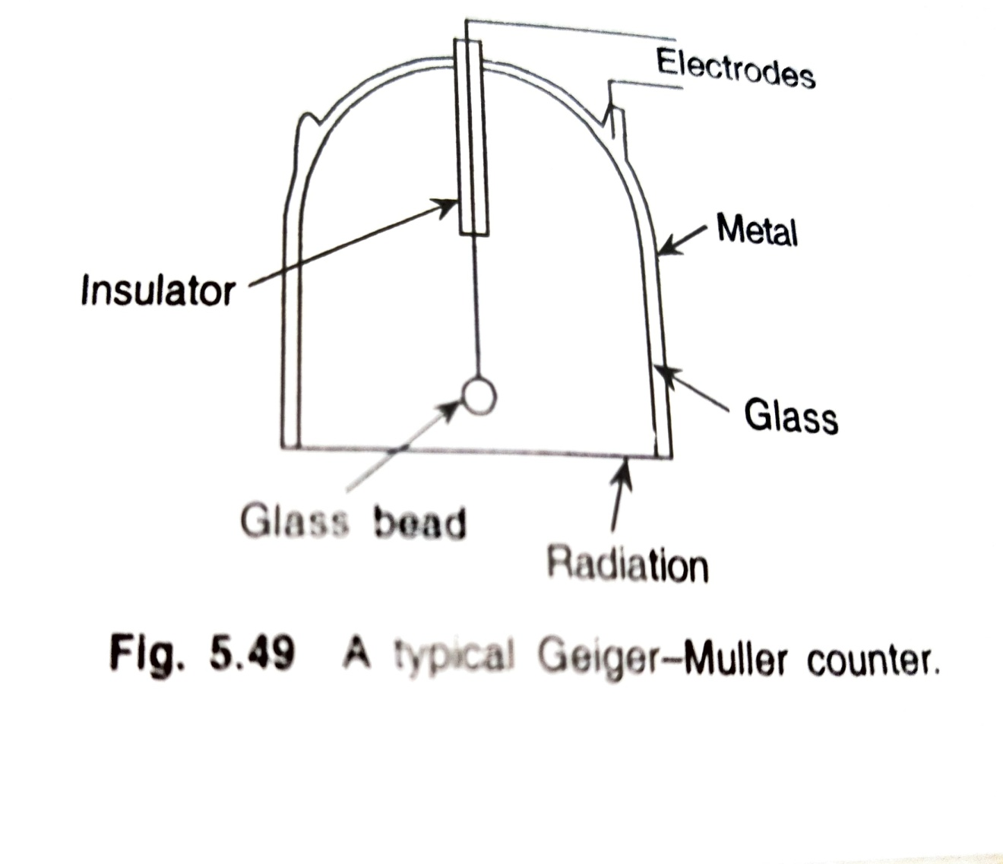
End-Window type

Slide 63
End-Window type
In the end window type, a metal coated glass tube of cylindrical form has a thin tungsten wire of 0.002-0.01 cm diameter passing through the centre acting as the collector electrode with the body as the other.
The end window s usually made of mica sheet of a thickness less than 1 mg/cm².
To avoid spark over the central electrode, it terminates into a glass bead .
Radiation is received by the end window.

Slide 64
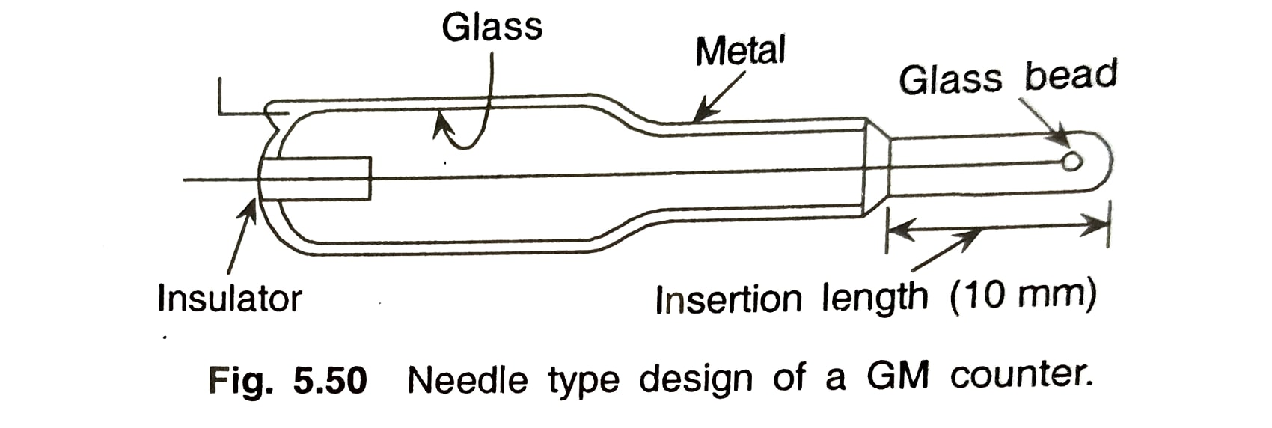
Cylindrical& Needle type
In the cylindrical GM counters,radiation is received by the side walls.
In the Needle type GM counter, where insertion in a narrow channel s required.

Slide 65
Geiger Counter
The GM counter chamber uses a gas at a low pressure of about 0.1-0.15 kg/cm² that consists of 90% insert gas such as Ar & Ne and 10% ethyl alcohol or other organic vapours like methane.
This mixture ensures charge transit through electrons only.
One important thing in gas filled counters is the discharges mechanism.
In the GM counter, the Townsend discharge occurs and with the bulk of electrons in the discharge being collected by the anode, a positive ion sheath or cloud is left to reduce the field and stop the discharge. This is known as Quenching of the discharge.

Slide 66
Scintillation Detectors
Certain single crystals of organic or inorganic materials, activated glasses/liquids or plastic fluors have the property that when they receive high energy radiation, they produce very short duration light pulses or flashes called “Scintillations”.
These materials are known as Scintillators.

Slide 67
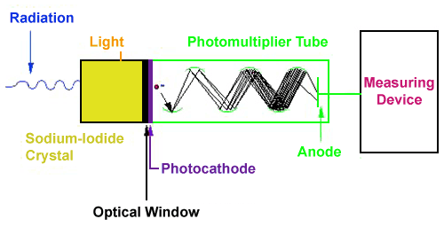
Scintillation Detector

Slide 68
Scintillation Detectors
The basic principle behind this instrument is the use of a special material which glows or "scintillates" when radiation interacts with it.
The most common type of material is a type of salt called sodium-iodide. The light produced from the scintillation process is reflected through a clear window where it interacts with device called a photomultiplier tube.
The first part of the photomultiplier tube is made of another special material called a photocathode.
The photocathode produces electrons when light strikes its surface.

Slide 69
Scintillation Detectors
These electrons are then pulled towards a series of plates called dynodes through the application of a positive high voltage.
When electrons from the photocathode hit the first dynode, several electrons are produced for each initial electron hitting its surface.
This "bunch" of electrons is then pulled towards the next dynode, where more electron "multiplication" occurs.
The sequence continues until the last dynode is reached, where the electron pulse is now millions of times larger then it was at the beginning of the tube.

Slide 70
Application of Radiation Sensors
They are widely used in medical applications for image generation (X-rays and tomography), as well as high-energy physics experiments, plant laboratories, airports security (X-rays machines), and radiation sensing for nuclear installations.
https://youtu.be/TnvAQ9ZHDyE -GM counter https://youtu.be/ogJX9JOndI8 - Scintillation detector

